Slide 1


Fundamentals of Accounting
B. Tech Sem 5
2101MN503
Prof. Javed S. Nathani
javed.nathani@darshan.ac.in
91066 34874

Slide 2
Unit - 1 Introduction to Accounting
B. Tech Sem 5
2101MN503
Prof. Javed S. Nathani
javed.nathani@darshan.ac.in
91066 34874

Slide 3
What is Accounting?
Accounting is often called language of business.
Accounting is a common language used to communicate financial information from one person to another.
Accounting is a social science which has its concepts and principles which are used in applying the accounting cycle to achieve accounting functions and objectives.

Slide 4
Definition of Accounting
According to American Institute of Certified Public Accountants (AICPA),
“ Accounting is an art of recording, classifying and summarizing in a significant manner and in terms of money, transactions and events, which are in part at least, of financial character and interpreting the reasons thereof. ”

Slide 5
Users of Accounting Information

Slide 6
The Accounting Information System
Accounting is an information system, which converts inputs into outputs.
The accounting system processes business transactions to provide information to various interested parties.
There are external and internal users of the information produced by the accounting system of a firm.

Slide 7
Users of Accounting Information
Users
Internal Users
Owners
Management
Employees
External Users
Investors
Lenders
Suppliers and other trade creditors
Customers
Governments and their agencies
Public

Slide 8
Process of Accounting

Slide 9
Process/Cycle of Accounting
1.Identifying the transaction
2.Recording in Journal
3.Posting in ledger
4.Preparing Trial balance
6.Financial Statements
5.Adjusting entries
7.Closing the books

Slide 10
Process of Accounting
I. Identifying financial transactions and events
Accounting records only those transactions and events which are of financial nature.
So, first of all, such transactions and events are identified.
II. Measuring the transactions
Accounting measures the transactions and events in terms of money which are considered as a common unit.
III. Recording of transactions
Accounting involves recording the financial transactions in appropriate book of accounts such as Journal or Subsidiary Books.

Slide 11
Process of Accounting
IV. Classifying the transactions
Transactions recorded in the books of original entry – Journal or Subsidiary books are classified and grouped according to their nature and posted in separate accounts known as ‘Ledger Accounts’.
V. Summarising the transactions
It involves presenting the classified data in a manner and in the form of statements, which are understandable by the users.
It includes Trial balance, Trading Account, Profit and Loss Account and Balance Sheet.

Slide 12
Process of Accounting
VI. Analyzing and interpreting financial data
Results of the business are analyzed and interpreted so that users of financial statements can make a meaningful and sound judgment.
Financial data is analyzed through Common size statement, Comparative financial statement, Trend Analysis, Ratio analysis, etc.
VII. Communicating the financial data or reports to the users
Communicating the financial data to the users on time is the final step of Accounting so that they can make appropriate decisions.

Slide 13
Types of Transactions

Slide 14
Types of Transactions
Types
Of
Transactions
Economic
Transactions
Cash Transactions
Credit Transactions
Non-economic
Transactions

Slide 15
Types of Transactions
1.) Economic Transactions :
Those transactions in which money is exchanged, or such things or services are exchanged which can be measured in terms of money are called economic transactions. E.g., Goods purchased from Abhishek for Rs. 50,000.
2.) Non-economic Transactions :
Those transactions in which money is not exchanged nor there is an exchange of such things. And it can not be measured in terms of money are called non-economic transactions. E.g., invitation to a friend for dinner.

Slide 16
Types of Economic Transactions
1.) Cash Transactions :
A transaction in which there is a receipt or payment of cash is a cash transaction. Cash balance is affected by such a transaction.
2.) Credit Transactions :
In credit transaction, there is no receipt or payment of cash taking place immediately, but it is postponed to some future date. It is a transaction in which no cash is exchanged.

Slide 17
Classification of Accounts

Slide 18
What is an Account?
An account is a summary of all business transactions, relating to one person or item.
It is a two-sided statement, which records a group of similar transactions relating to one person, one kind of property or one class of expenses or incomes.
It is divided into two parts. Left hand side is known as “Debit” side and right hand side is known as “Credit” side.

Slide 19
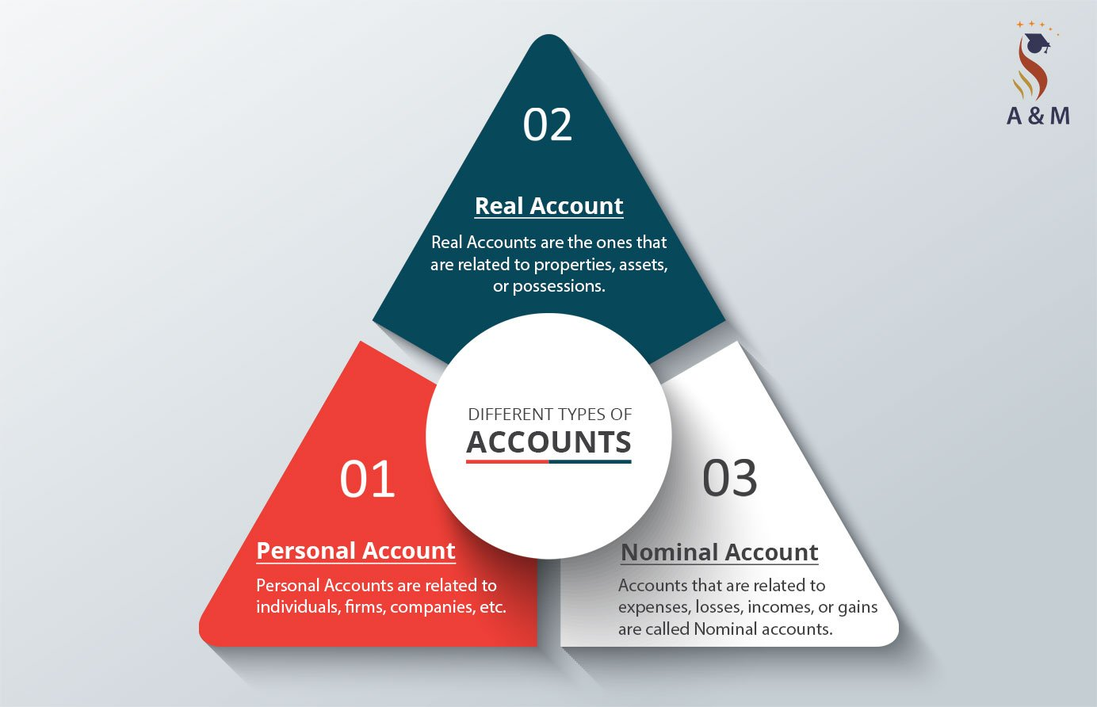
Types of Accounts
1.) Personal Account
2.) Real Account
3.) Nominal Account
19

Slide 20
Classification of Accounts
Classification of Accounts
Personal વ્યક્તિ
Individuals, firms, companies, associations, co-operative society, etc.
Ram’s A/c, RMC A/c, LIC A/c, BOI A/c, TATA Ltd. A/c
Impersonal બિન-વ્યક્તિ
Real માલ-મિલકત
Belongings to enterprise
Building A/c Machine A/c, Cash A/c, Stock A/c
Nominal ઊપજ-ખર્ચ
Incomes and expenses
Rent, Salary, commission received/paid

Slide 21
1) Personal Account
These accounts are related to persons. These persons may be natural persons like Raj’s account, Rajesh’s account, Ramesh’s account, Suresh’s account, etc.
These persons can also be artificial persons like partnership firms, companies, bodies corporate, an association of persons, etc. For example – Rajesh and Suresh trading Co., Charitable trusts, XYZ Bank Ltd, C company Ltd, etc.

Slide 22
2) Real Account
The accounts relating to goods and other property are known as Real Accounts.
They are further classified as Tangible real account and Intangible real accounts.
Tangible Real Accounts: These include assets that have a physical existence and can be touched. For example – Building A/c, cash A/c, stationery A/c, inventory A/c, etc.
Intangible Real Accounts: These assets do not have any physical existence and cannot be touched. However, these can be measured in terms of money and have value. For Example – Goodwill, Patent, Copyright, Trademark, etc.

Slide 23
3) Nominal Account
These accounts are related to income or gains and expenses or losses.
For example: – Rent A/c, commission received A/c, salary A/c, wages A/c, conveyance A/c, etc.

Slide 24
Rules of Debit and Credit

Slide 25
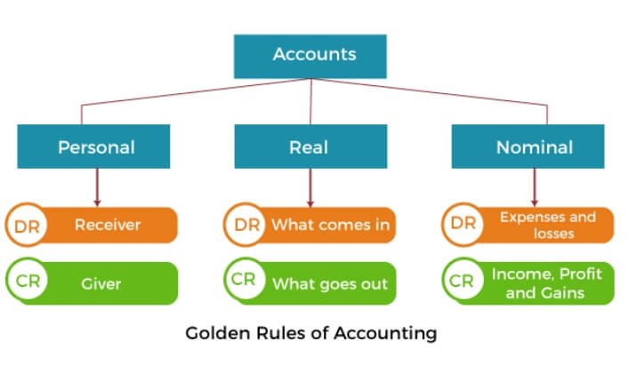
Rules of Debit and Credit

Slide 26
Three Golden Rules of Accounts
Accounts
Personal
વ્યક્તિ
“Debit the receiver, Credit the giver”
લાભ લેનાર ખાતે ઉધાર, લાભ આપનાર ખાતે જમા
Real માલ-મિલકત
“Debit what comes in, Credit what goes out”
મિલકત આવે તે ઉધાર, જાય તે જમા
Nominal ઊપજ–ખર્ચ
“Debit the expenses and losses, Credit the income and gains”
ખર્ચ કે નુકશાન ખાતે ઉધાર, ઊપજ કે આવક ખાતે જમા

Slide 27
1) Rules for Personal Account
The account of the person who receives the benefit is debited and the account of the person who gives the benefit is Credited.
“DEBIT THE RECEIVER AND CREDIT THE GIVER”
E.g., Paid Rs. 500 to Vipul.

Slide 28
2) Rules for Real Account
When an asset comes into the business, the asset account is debited, because the asset gets the benefit. Similarly, when an asset goes out of the business, the asset account is credited because it gives the benefit.
“DEBIT WHAT COMES IN AND CREDIT WHAT GOES OUT”
E.g., Sold goods to Mr. A Rs. 1000.

Slide 29
3) Rules for Nominal Account
When expenses or losses are incurred, their accounts must be debited.
Whenever, the incomes are received, the income account must be credited.
“DEBIT EXPENSES AND LOSSES AND CREDIT INCOMES AND GAINS”
E.g., Paid salaries Rs. 1000.

Slide 30
Steps for Debiting or Crediting An Account
Check, whether it can be recorded in the books (Type of transaction)
Determine which accounts are getting affected
Determine the types of accounts
Apply the rules of Debit and Credit

Slide 31
Characteristics of Accounting

Slide 32
Characteristics of Accounting
1. Reliability (વિશ્વસનીયતા/ભરોસાપાત્રતા)
The reliability of accounting statistics is set by way of the correspondence between what the facts convey about the transactions or occasions that have occurred, measured, and displayed.
A piece of dependable information should be free from error and bias and faithfully represents what it’s meant to represent.
To make certain reliability, the facts disclosed should be credible and verifiable by way of unbiased events.

Slide 33
Characteristics of Accounting
2. Relevance (સુસંગતતા)
To be relevant, facts have to be accessible in time, ought to help in prediction and feedback, and ought to affect the selections of customers with the aid of:
assisting them to shape prediction about the results of past, current, or future events; and/or
confirming or correcting their previous evaluations.

Slide 34
Characteristics of Accounting
3. Understandability (સમજી શકાય તેવું)
Understandability is the capability of the decision-makers to interpret accounting information in an identical experience as it is organized and conveyed to them.
The qualities that distinguish between the right and awful conversation during a message are integral to the understandability of the message.
A message is said to be successfully communicated when it is interpreted through the receiver of the message in the equal experience in which the sender has sent.
Accountants should present the same facts in the most intelligible manner without sacrificing relevance and reliability.

Slide 35
Characteristics of Accounting
4. Comparability
It is not ample that the economic data is applicable and dependable at a singular time, during a specific circumstance, or for a singular reporting entity.
But it’s equally necessary that the purchasers of the regularly occurring motive economic reports can evaluate a variety of things of an entity over a definite time duration and with different entities.
To be comparable, accounting reviews need to belong to a standard duration and use a frequent unit of size and structure of reporting.

Slide 36
Objectives of Accounting

Slide 37
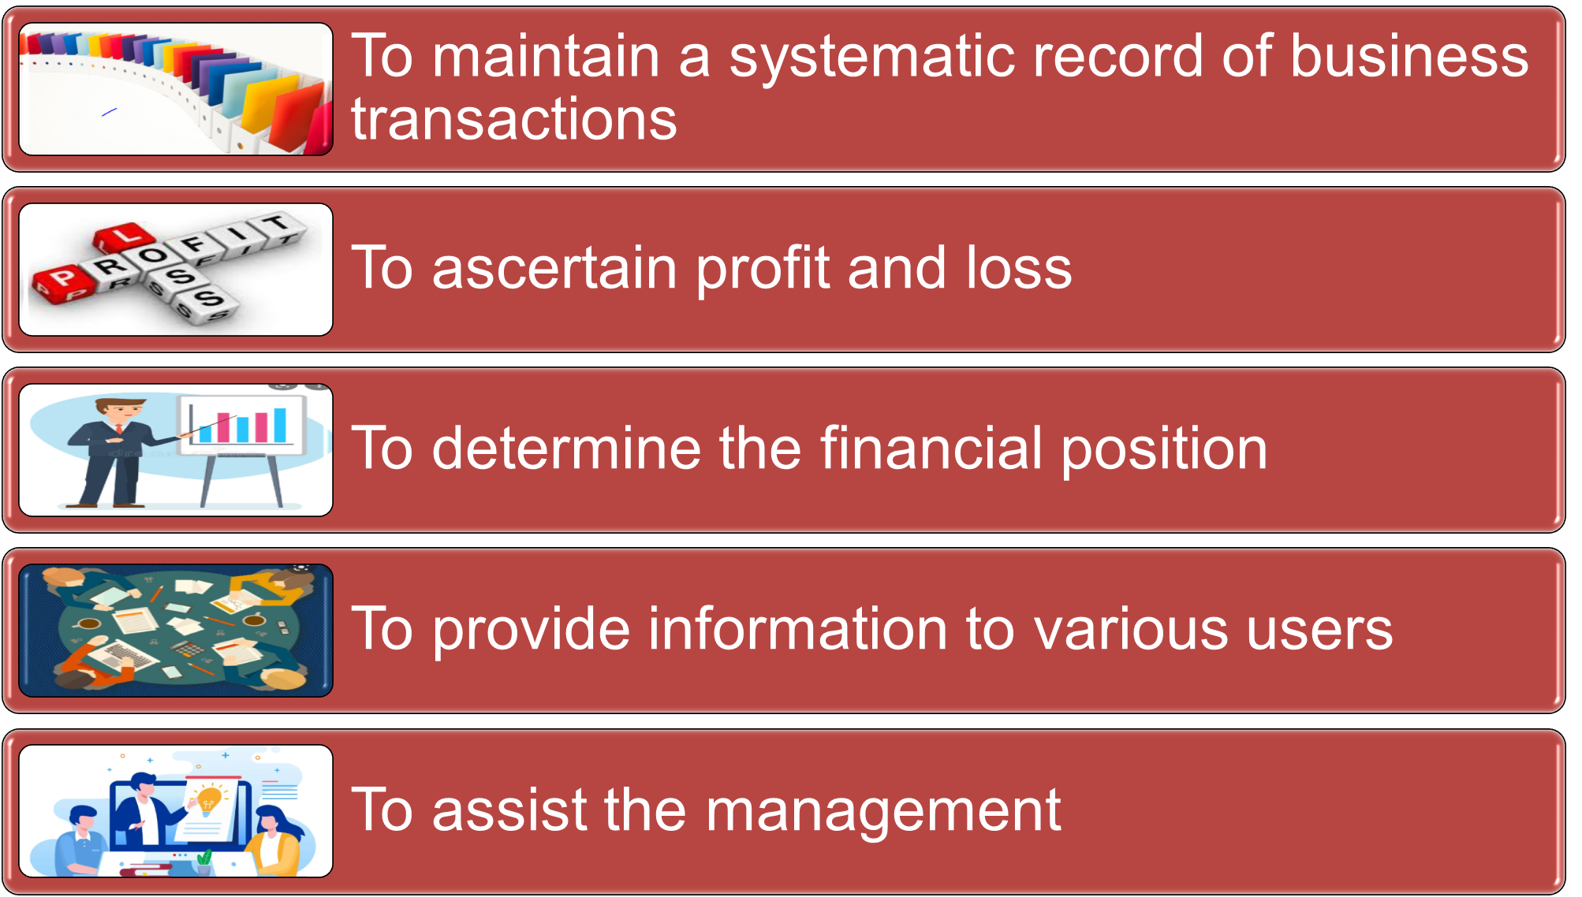
Objectives of Accounting

Slide 38
Advantages and Disadvantages of Accounting

Slide 39
Advantages of Accounting
A complete and systematic record
Valuation of the enterprise
Evidence in court
In accordance with the law
Inter-company or intra-company comparison
Facilitates auditing
Facilitates Financial Analysis
Effective management

Slide 40
Disadvantages of Accounting
Does not guarantee accuracy
Accounting ignores the qualitative element
Accounts can be manipulated
Costly for a small business
Business Privacy
Ignores the concept of time value of money
Accounting policies differs from one business unit to another

Slide 41
Branches of Accounting

Slide 42
Branches of Accounting
Stewardship Accounting
Financial Accounting
Cost Accounting
Management Accounting
Social Responsibility Accounting
Human Resource Accounting
Environmental Accounting
Current cost Accounting

Slide 43
1) Stewardship Accounting
The Steward is the Manager, who is entirely responsible for the estate that owned by the owner.
The owner use to visit once in a year or two and would verify the financial transactions of his properties managed by the manager.

Slide 44
2) Financial Accounting
Financial accounting is the original form of accounting.
It is primarily concerned with record-keeping of financial transactions directed towards preparation of final accounts / statements.
Its main purposes are :
Recording the transactions
Preparation of final accounts
Reporting to the users of accounting information

Slide 45
3) Cost Accounting
Cost accounting is that part of accounting which deals with the accumulation, classification, recording, allocation, summarization and reporting of current and future costs.
It is the systematic procedure for determining the cost per unit of the product or a service.

Slide 46
4) Management Accounting
Management accounting is the combination of ‘Financial Accounting’ and ‘Cost Accounting’.
It is that part of accounting which is concerned with internal reporting to the top management.
It relates to planning, control and decision making.

Slide 47
5) Social Responsibility Accounting
The days are away when business organization had objective of only profit earning.
The enterprise has not only to prove its utilization of funds for earning profit, but also has to work towards well being of the society.
The Government of India has made it mandatory to make CSR (Corporate Social Responsibility Voluntary Disclosure) from 21st December 2009.
According to guidelines, business should cover some core elements, such as: Care for all stake holders, Ethical functioning, Respect to workers’ right and welfare, Respect for human rights, Respect for environment, Activities for social and inclusive development.

Slide 48
6) Human Resource Accounting
The human resources are vital for any enterprises having large number of employees.
The long term planning of qualitative human resource variables results in greater benefits in the long run.
An accountant always views assets (including human assets) as something with a value on the balance sheet as yet; Human Resource value does not appear as an ‘Asset’.
The cost of HR encompasses: Cost of recruiting, Cost of selection, Cost of contracting, Cost of placing, Cost of training, Cost of orientation, Cost of promotion, Cost of improvement, Cost of substitution, Opportunity cost, Exit cost, Etc.

Slide 49
7) Environmental Accounting
Responsibility towards environment has become one of the most crucial areas of social responsibility.
The era is alarming the global warming due to deforestation, pollution of air, water and sound. And it has tremendously affected the environment, not only its nearby areas but, of city, the country and nation at large.
A tradeoff between environmental protection and development is required.

Slide 50
8) Current Cost Accounting
Current cost accounting attempts to provide more realistic approach of financial position of an enterprise by valuing assets at current replacement cost, rather than historical cost (the amount actually paid for them).
The problems that current cost accounting attempts to solve are obviously linked to inflation.

Slide 51
Accounting Concepts and Accounting Conventions

Slide 52
Concepts of Accounting
The term accounting concepts refer to basic rules, assumptions, and principles which act as a primary standard for recording business transactions and maintaining books of accounts.
Money Measurement Concept
The Going Concern Concept
The Business Entity Concept
The Realization Concept
Accrual / Matching Concept
Historical Cost Concept
Periodicity Concept
Dual Aspect Concept
52

Slide 53
1) Money Measurement Concept
All business transactions are expressed, recorded and measured only in terms of money.
Monetary Unit – money is the common denominator. In India, Rupee is the unit.
E.g., Accounting doesn’t tell how good the quality of employees’ skills are although this is important for the success of the business.

Slide 54
2) The Going Concern Concept
This concept implies that the business will continue to operate for the foreseeable future.
Going Concern – company to last long enough to fulfill objectives and commitments.
It is like continuous process, even if the founder of the business dies, business doesn’t stop.

Slide 55
3) Business Entity Concept
Business is distinct from the owners.
This concept implies that the affairs of a business are to be treated as being quite separate from the non-business activities of its owners.
Personal transactions of the owner should not be included.
Economic Entity – Company keeps its activity separate from its owners and other businesses.
Accounting record takes note of the dealing between business and owners just like outsiders. (Drawing and Capital)
E.g., A Director’s private car should not be included in the fixed assets of the company.

Slide 56
4) Realization Concept
This concepts holds to the view that profit can only be taken into account when realization has occurred.
Generally, sales revenue arising from the sale of goods are recognized when the goods are delivered to the customers.
Only order of goods is not done, we can make record only when goods are supplied.
E.g., Profit is earned when goods or services are provided to customers. Thus, it is incorrect to record profit when order is received, or when the customer pays for the goods.
Bad debts - when money is received from the debtors at that time only we remove it.

Slide 57
5) Accrual / Matching Concept
This concept says that net profit is the difference between revenues and expenses.
The revenues and relevant expenses incurred should be correlated and matched.
Revenues = expenses

Slide 58
6) Historical Cost Concept
All transactions and events are recorded at their monetary cost of acquisition.
Assets are normally shown at their original costs.
Any changes in the market value after the purchase are ignored.
E.g., A fixed asset acquired at a cost of Rs. 1,00,000 would be recorded at this amount in the books. Even if its market value may have gone up or down in the future, it should be recorded at its original cost of Rs. 1,00,000.

Slide 59
7) Periodicity / Time Period Concept
Business must be done at periodic intervals during the lifetime of the business enterprise.
PERIODICITY – Company can divide its economic activities into time periods.
Normal accounting period is 12 months.

Slide 60
8) Dual Aspect Concept
Every transaction has two effects : Debit and credit.
Accounting equation : A = C + L
Assets are equal to Capital & Liabilities.

Slide 61
Conventions of Accounting
Accounting conventions are guidelines used to help companies determine how to record certain business transactions that have not yet been fully addressed by accounting standards.
Materiality
Prudence / Conservatism
Consistency
Disclosure
61

Slide 62
1) Materiality
An item is material if its inclusion or omission would influence or change the judgment of a reasonable person.
New lead pencil is an asset, but its not needed to record. (Depreciation on Pencil)
In other words do not waste your time in the elaborate recording of trivial items.
E.g., a stock of stationary worth Rs. 10 should be treated as an expense when it was bought.
Miscellaneous expense

Slide 63
2) Prudence / Conservatism
The accountant should always be on the side of safety.
Consider all probable losses but not taking credit for favorable event, unless it takes place.
“Anticipate no profit & provide for all conceivable losses.”
E.g., Provision for doubtful debts should be deducted from debtors in balance sheet.
Closing stock – lower value is taken.

Slide 64
3) Consistency
Accounting policies must be consistent from year to year.
Same policies, procedures and methods are followed continuously.
Frequent changes in the accounting methods would lead to misleading profits calculated from the accounting records.
E.g., Depreciation method of certain fixed assets once adopted should be used in the following years.
FIFO Method – 1st year & LIFO Method – 2nd year

Slide 65
4) Disclosure
The financial statements of a firm must include all information necessary for the formation of valid decisions by the users.
Any information that might be relevant to an investor or creditor should be disclosed, either in body of the financial statements or in the notes attached thereto.
BEING, in journals
Notes or Contingent liabilities

